Slide 1
Probability
Independent Cases
Mathematical and Empirical Definition of Probability
Two basic Laws of Probability
Dependent Cases

Slide 2
PROBABILITY
The theory of Probability had its origin in games of chances and gambling, when there is a dispute in 1654 concerning the division of stake between two players whose game was interrupted before its close. So the dispute was solved by two famous Mathematicians :Blaise Pascal and Pierre de Fermat.

Slide 3
In 1662 Pascal’s fellow Jansenists Antoine Arnauld and Pierre Nicole used Probability in Mathematics.
Though Girolamo Cardano of Italy of 16th century is known as the father of Probability. He was a big Gambler and a good Chess player and was always in need of money ,who later made a sufficient money to support himself by Gambling. He wrote a book ‘ Liber de ludo aleae’., which was published after 100 years when people felt its importance.

Slide 4
Now lets explain the subject matter:
If we toss a coin we can easily predict Head or Tail , but if we toss Two Coins the result can’t be easily predictable, because the result
will be the combination of head and Tail. So any possibility of results in
such cases what we say is the Probability.
Use of probability in day to day life:
Probability is used in Statistics , Gambling, game theory ,in Weather reports , Blood sugar sampling and even in case of predicting the Sex of Baby at womb.

Slide 5
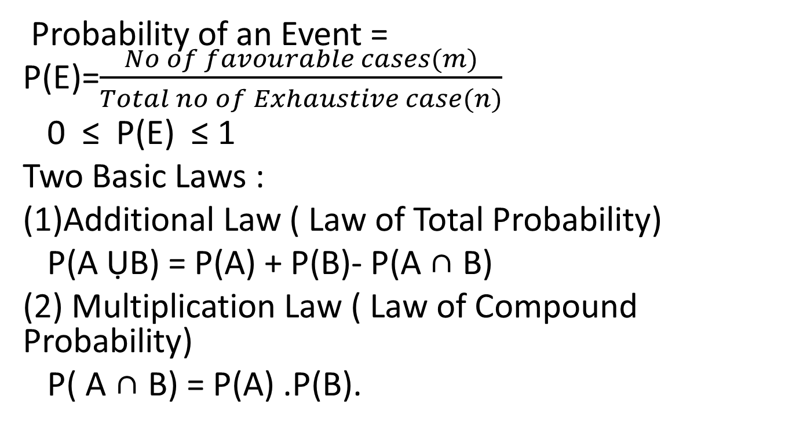
Probability of an Event = P(E)=$\frac{No of favourable cases(m)}{Total no of Exhaustive case(n)}$
0 ≤ P(E) ≤ 1
Two Basic Laws :
Additional Law ( Law of Total Probability)
P(A ỤB) = P(A) + P(B)- P(A ∩ B)
(2) Multiplication Law ( Law of Compound Probability)
P( A ∩ B) = P(A) .P(B).

Slide 6
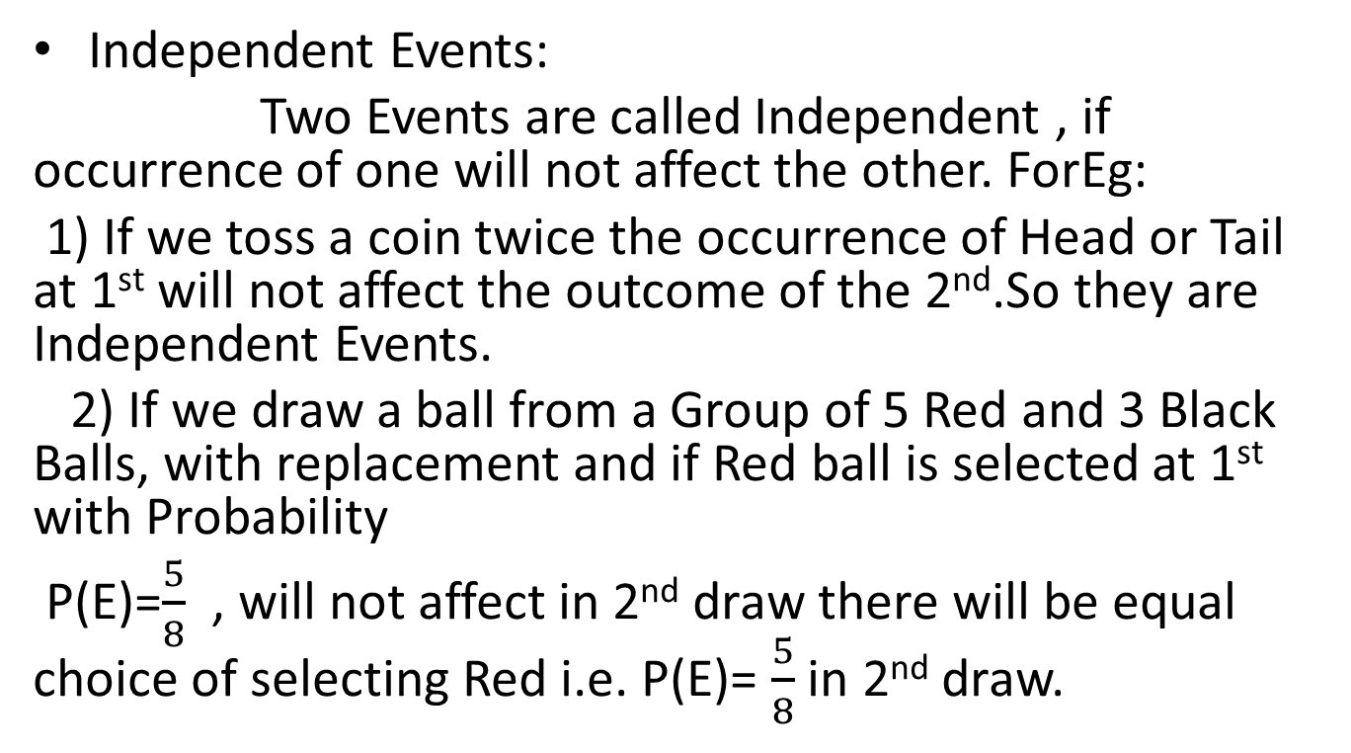
Independent Events:
Two Events are called Independent , if occurrence of one will not affect the other. ForEg:
1) If we toss a coin twice the occurrence of Head or Tail at 1st will not affect the outcome of the 2nd.So they are Independent Events.
2) If we draw a ball from a Group of 5 Red and 3 Black Balls, with replacement and if Red ball is selected at 1st with Probability
P(E)=$\frac{5}{8}$ , will not affect in 2nd draw there will be equal choice of selecting Red i.e. P(E)= $\frac{5}{8}$ in 2nd draw.

Slide 7
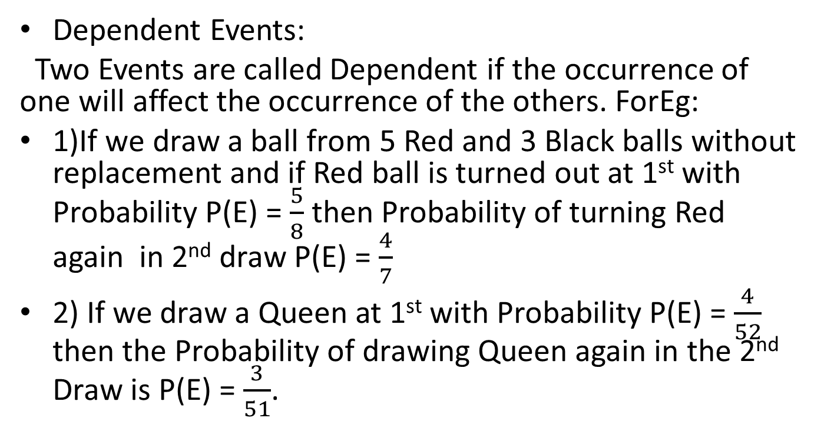
Dependent Events:
Two Events are called Dependent if the occurrence of one will affect the occurrence of the others. ForEg:
1)If we draw a ball from 5 Red and 3 Black balls without replacement and if Red ball is turned out at 1st with Probability P(E) = $\frac{5}{8}$ then Probability of turning Red again in 2nd draw P(E) = $\frac{4}{7}$
2) If we draw a Queen at 1st with Probability P(E) = $\frac{4}{52}$ then the Probability of drawing Queen again in the 2nd Draw is P(E) = $\frac{3}{51}$.

Slide 8
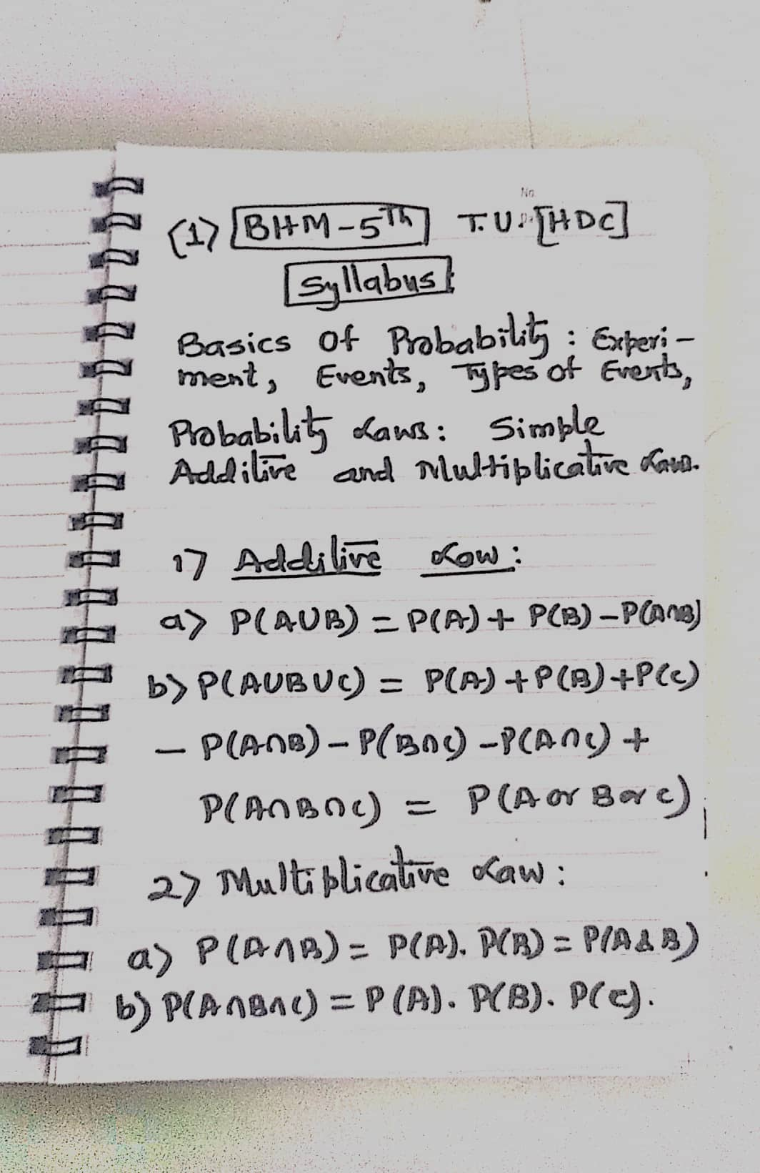

Slide 9
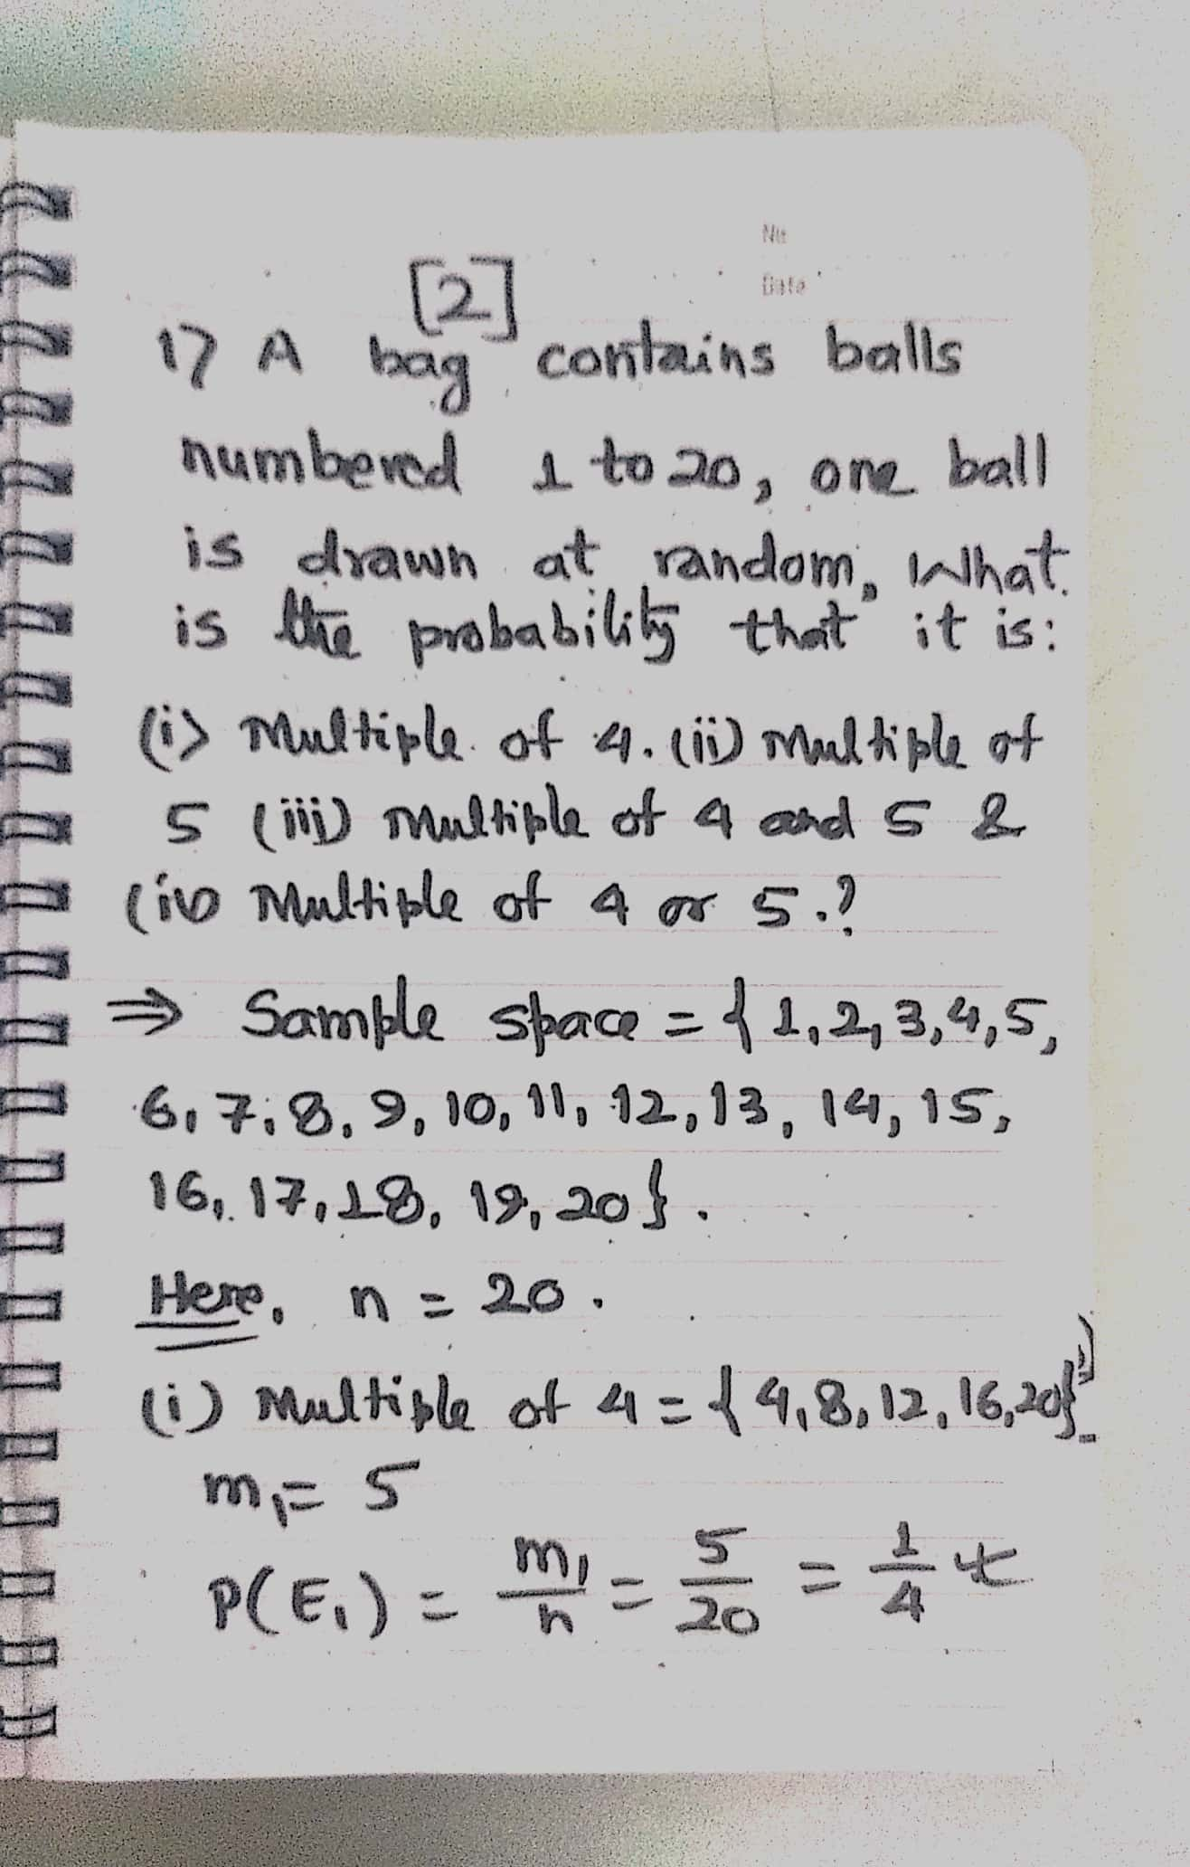

Slide 10
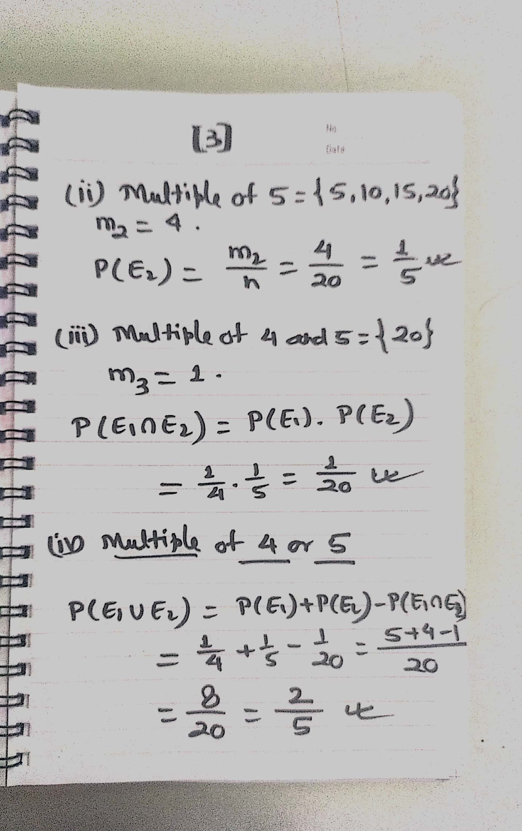

Slide 11
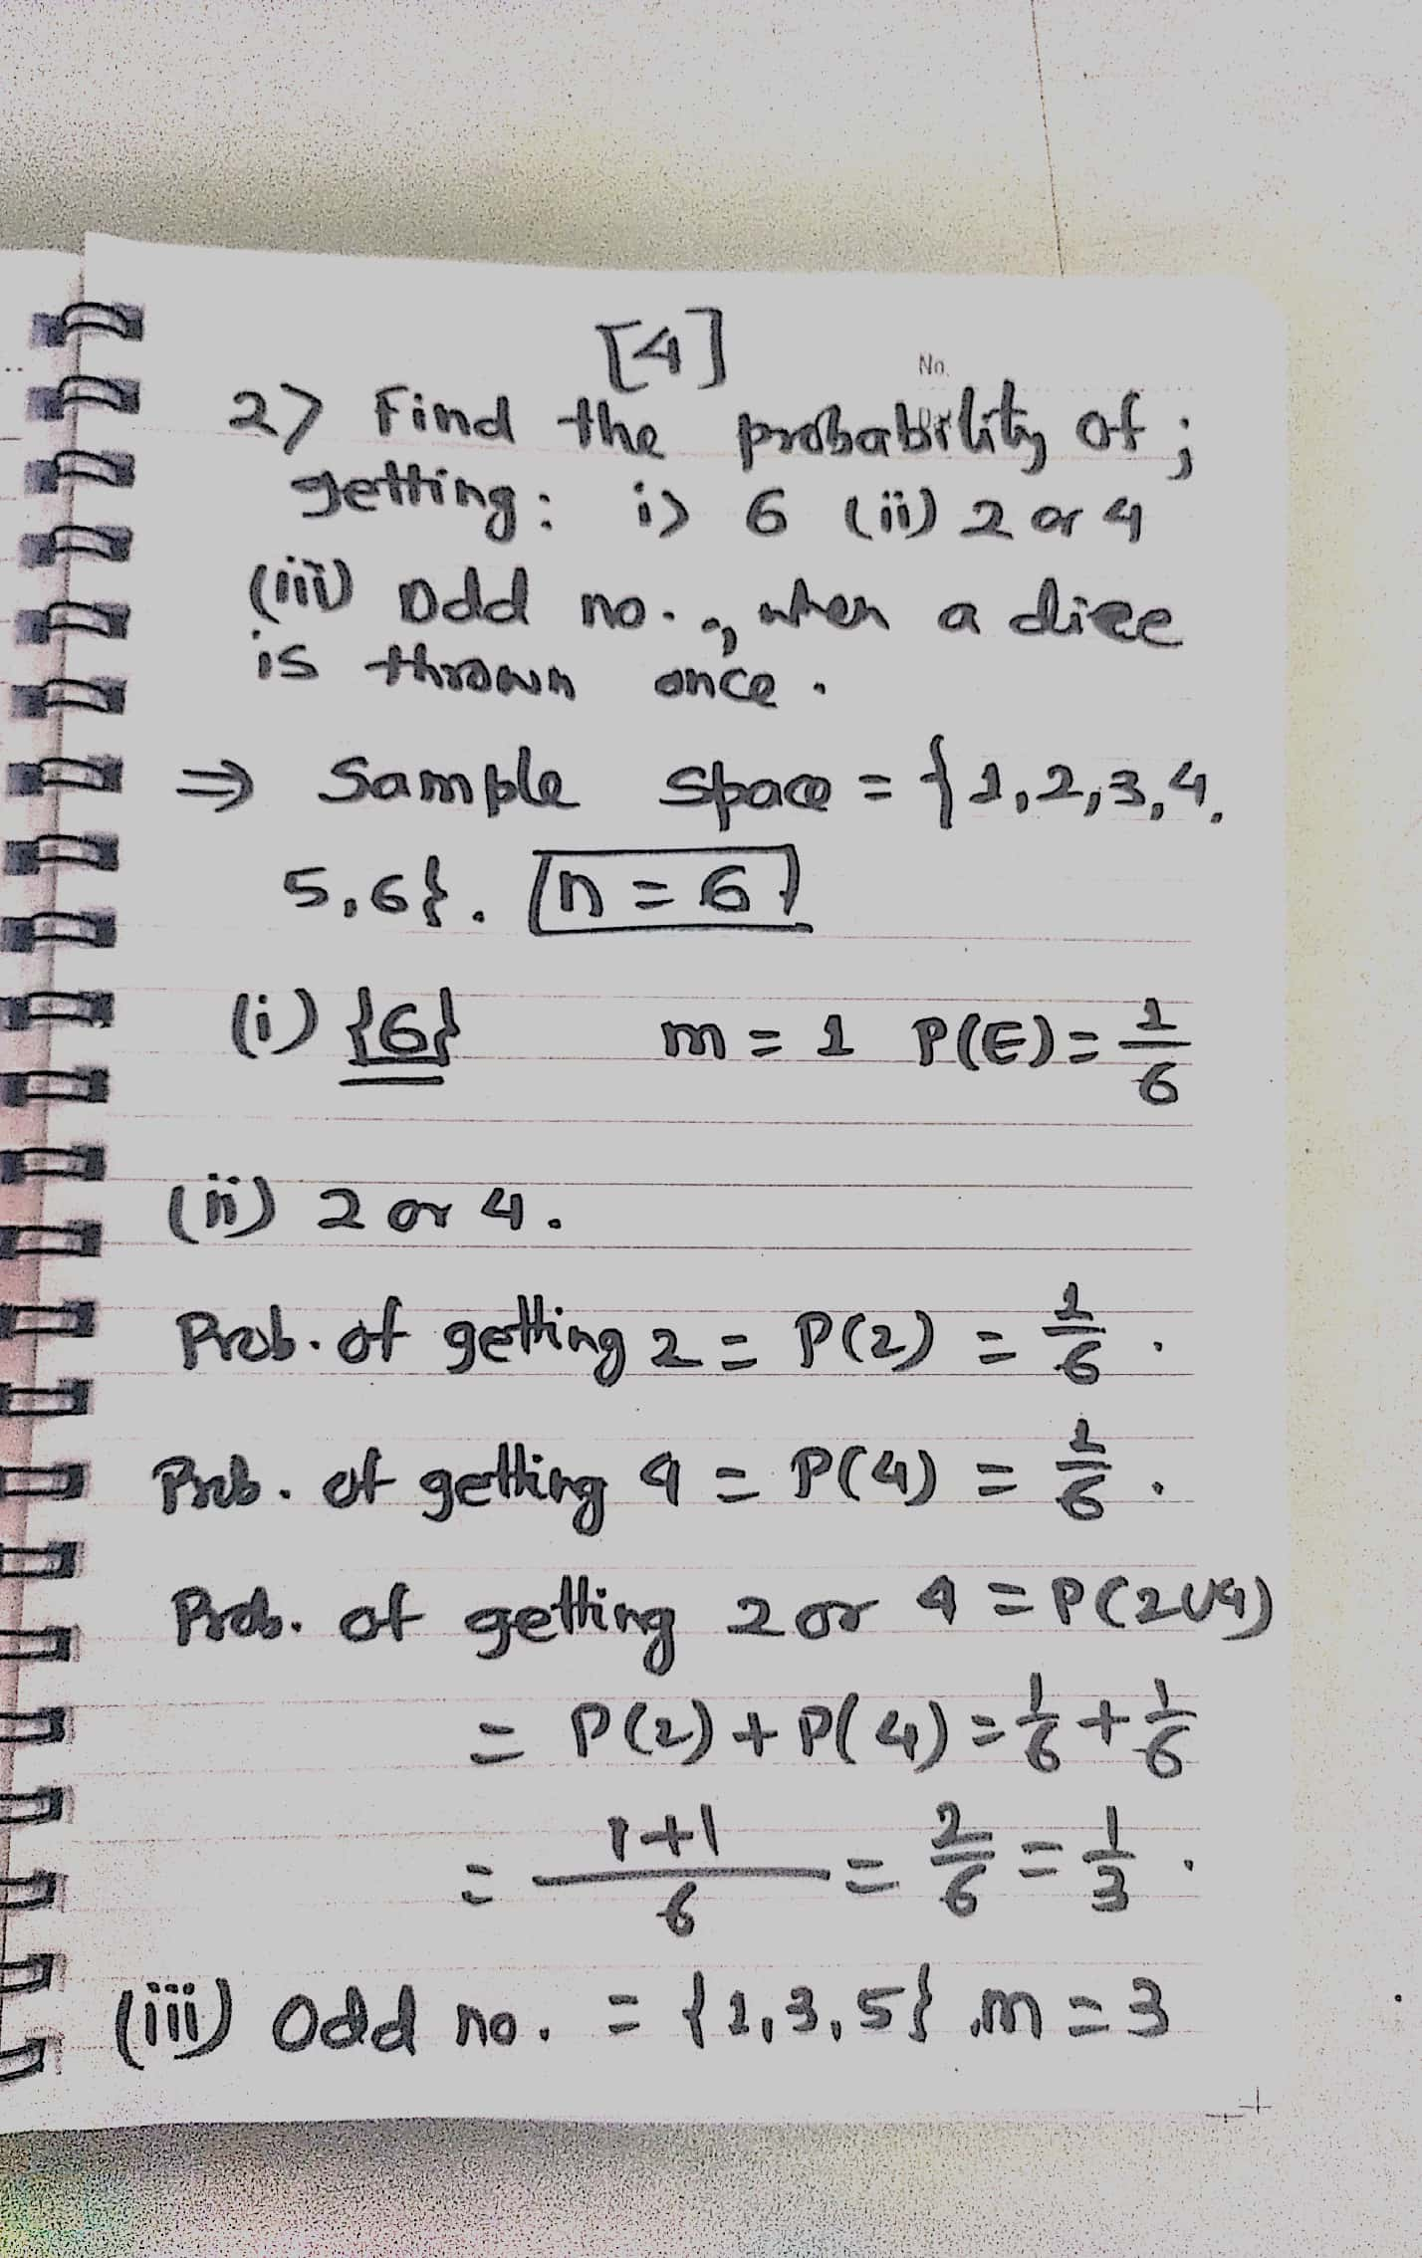

Slide 12
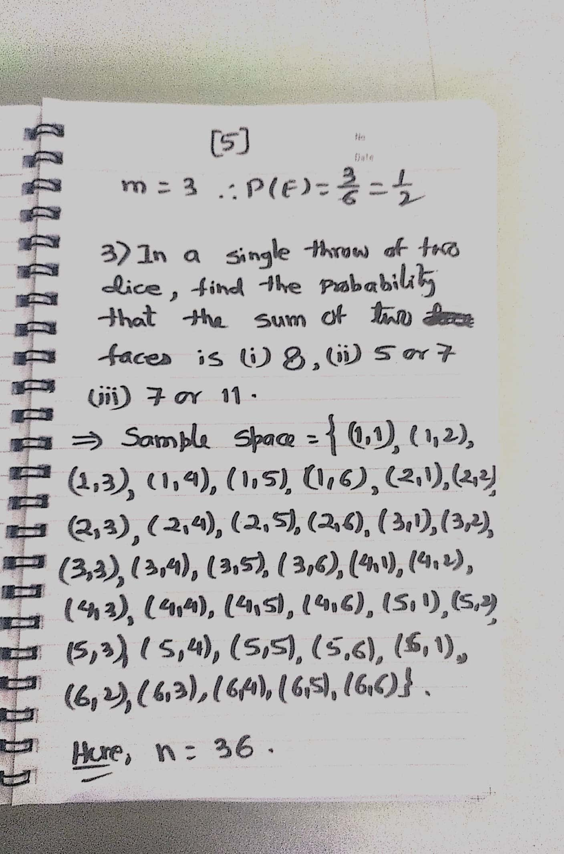

Slide 13
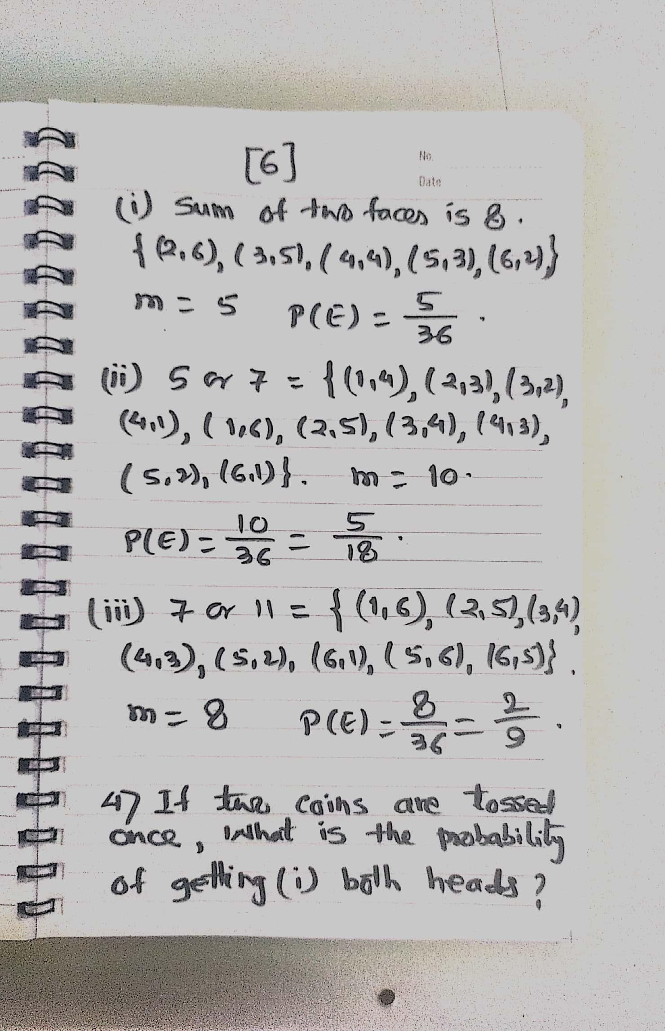

Slide 14
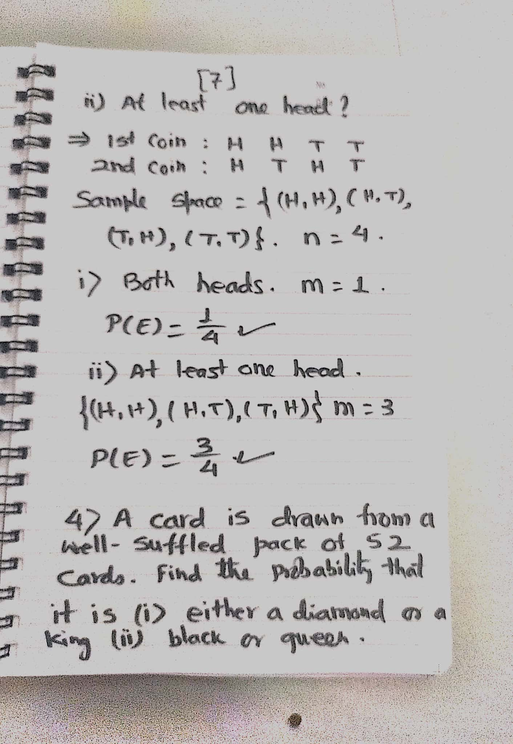

Slide 15
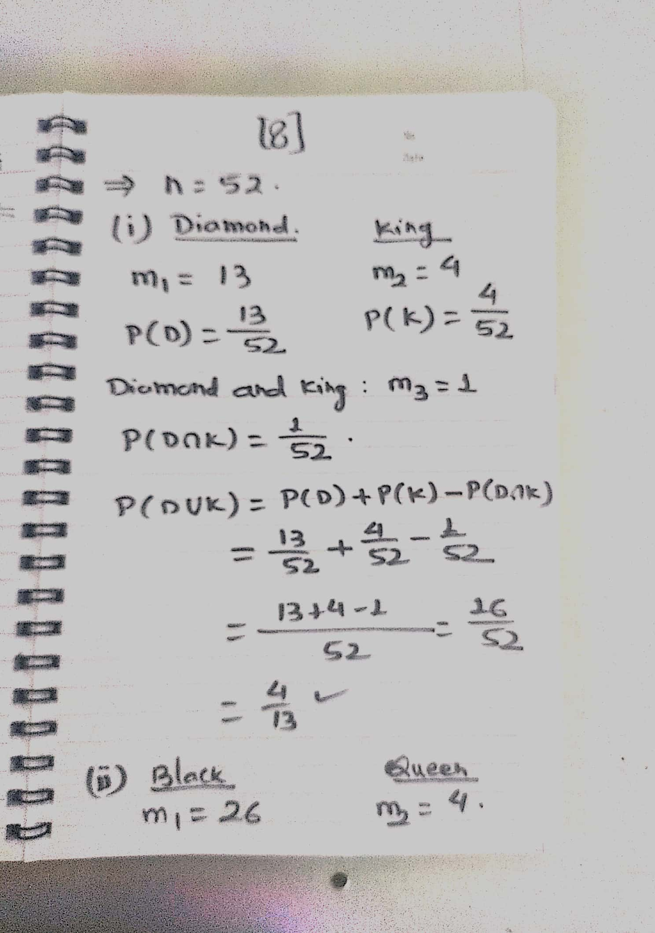

Slide 16
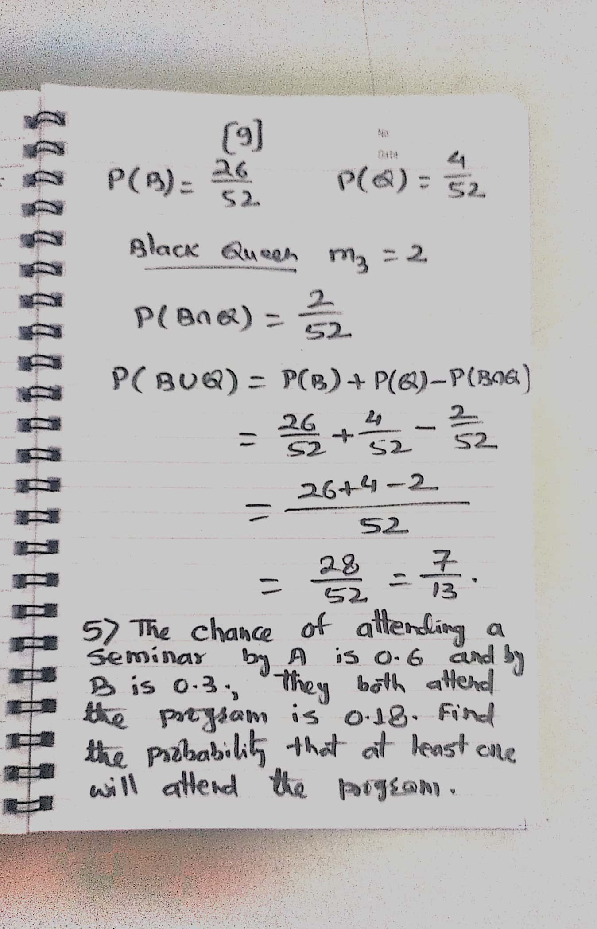

Slide 17
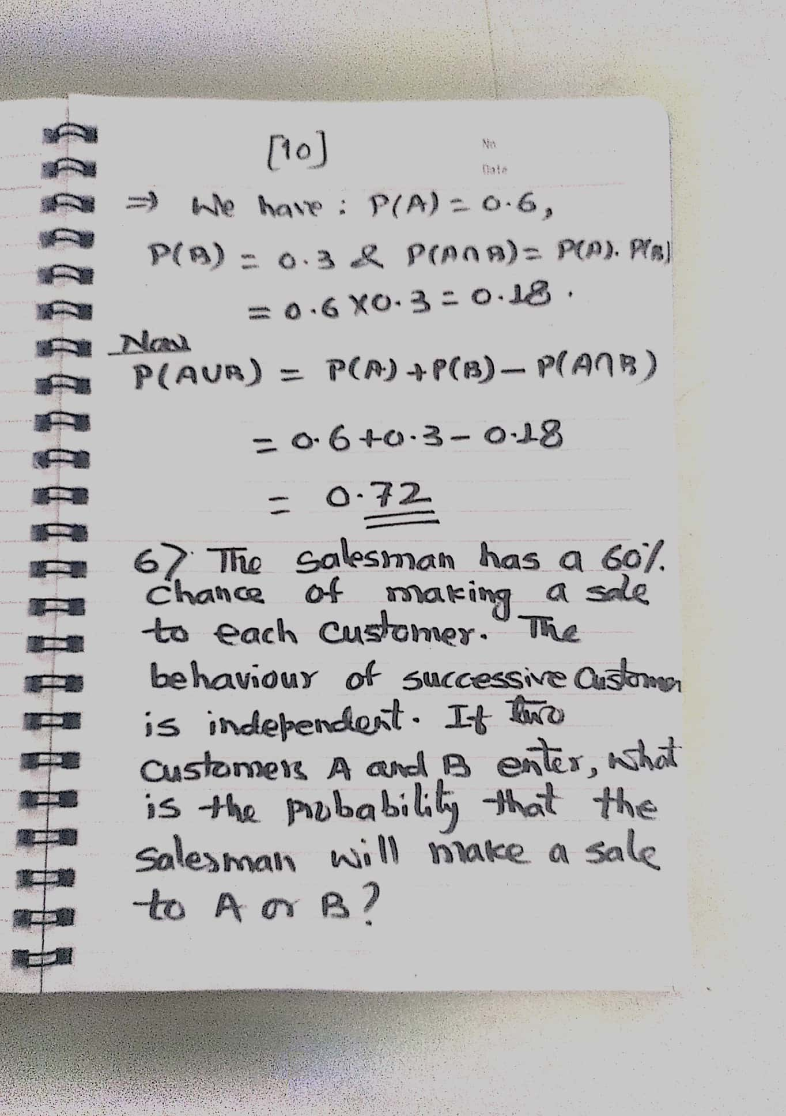

Slide 18
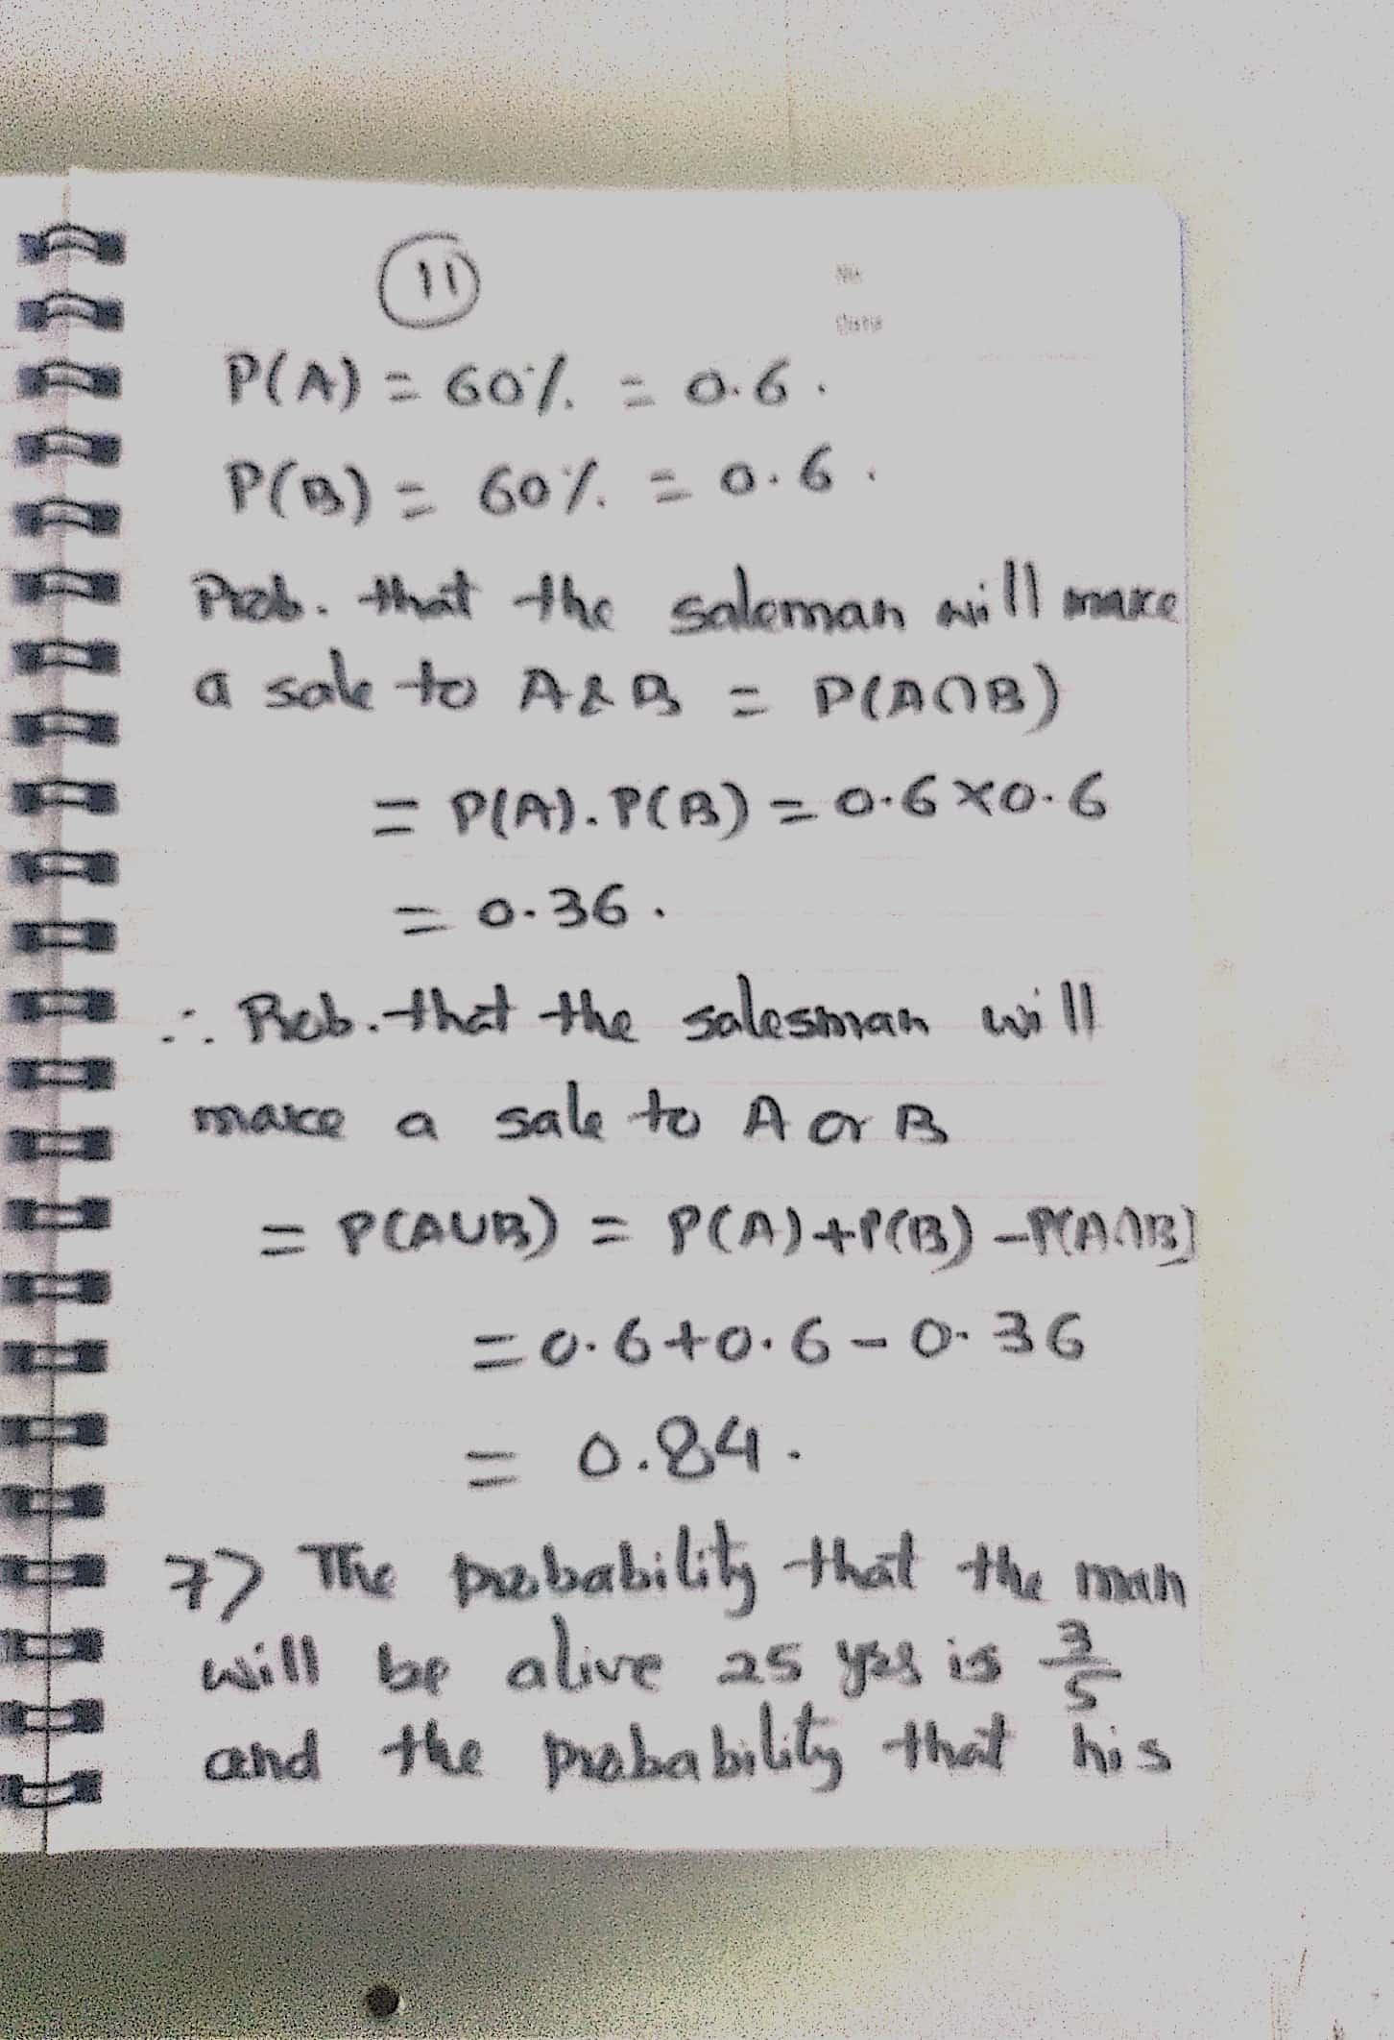

Slide 19
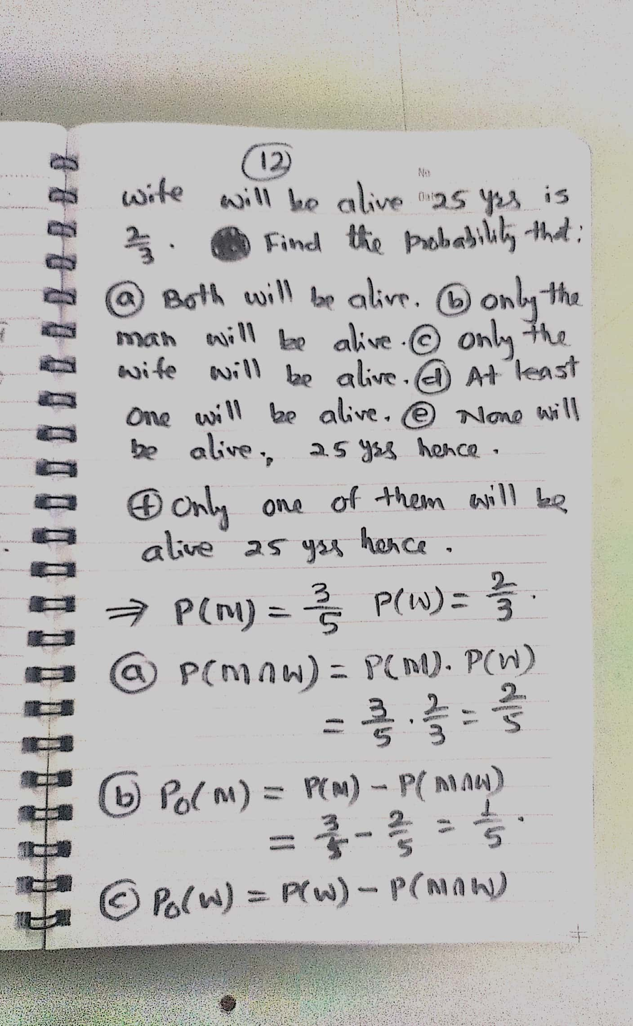

Slide 20
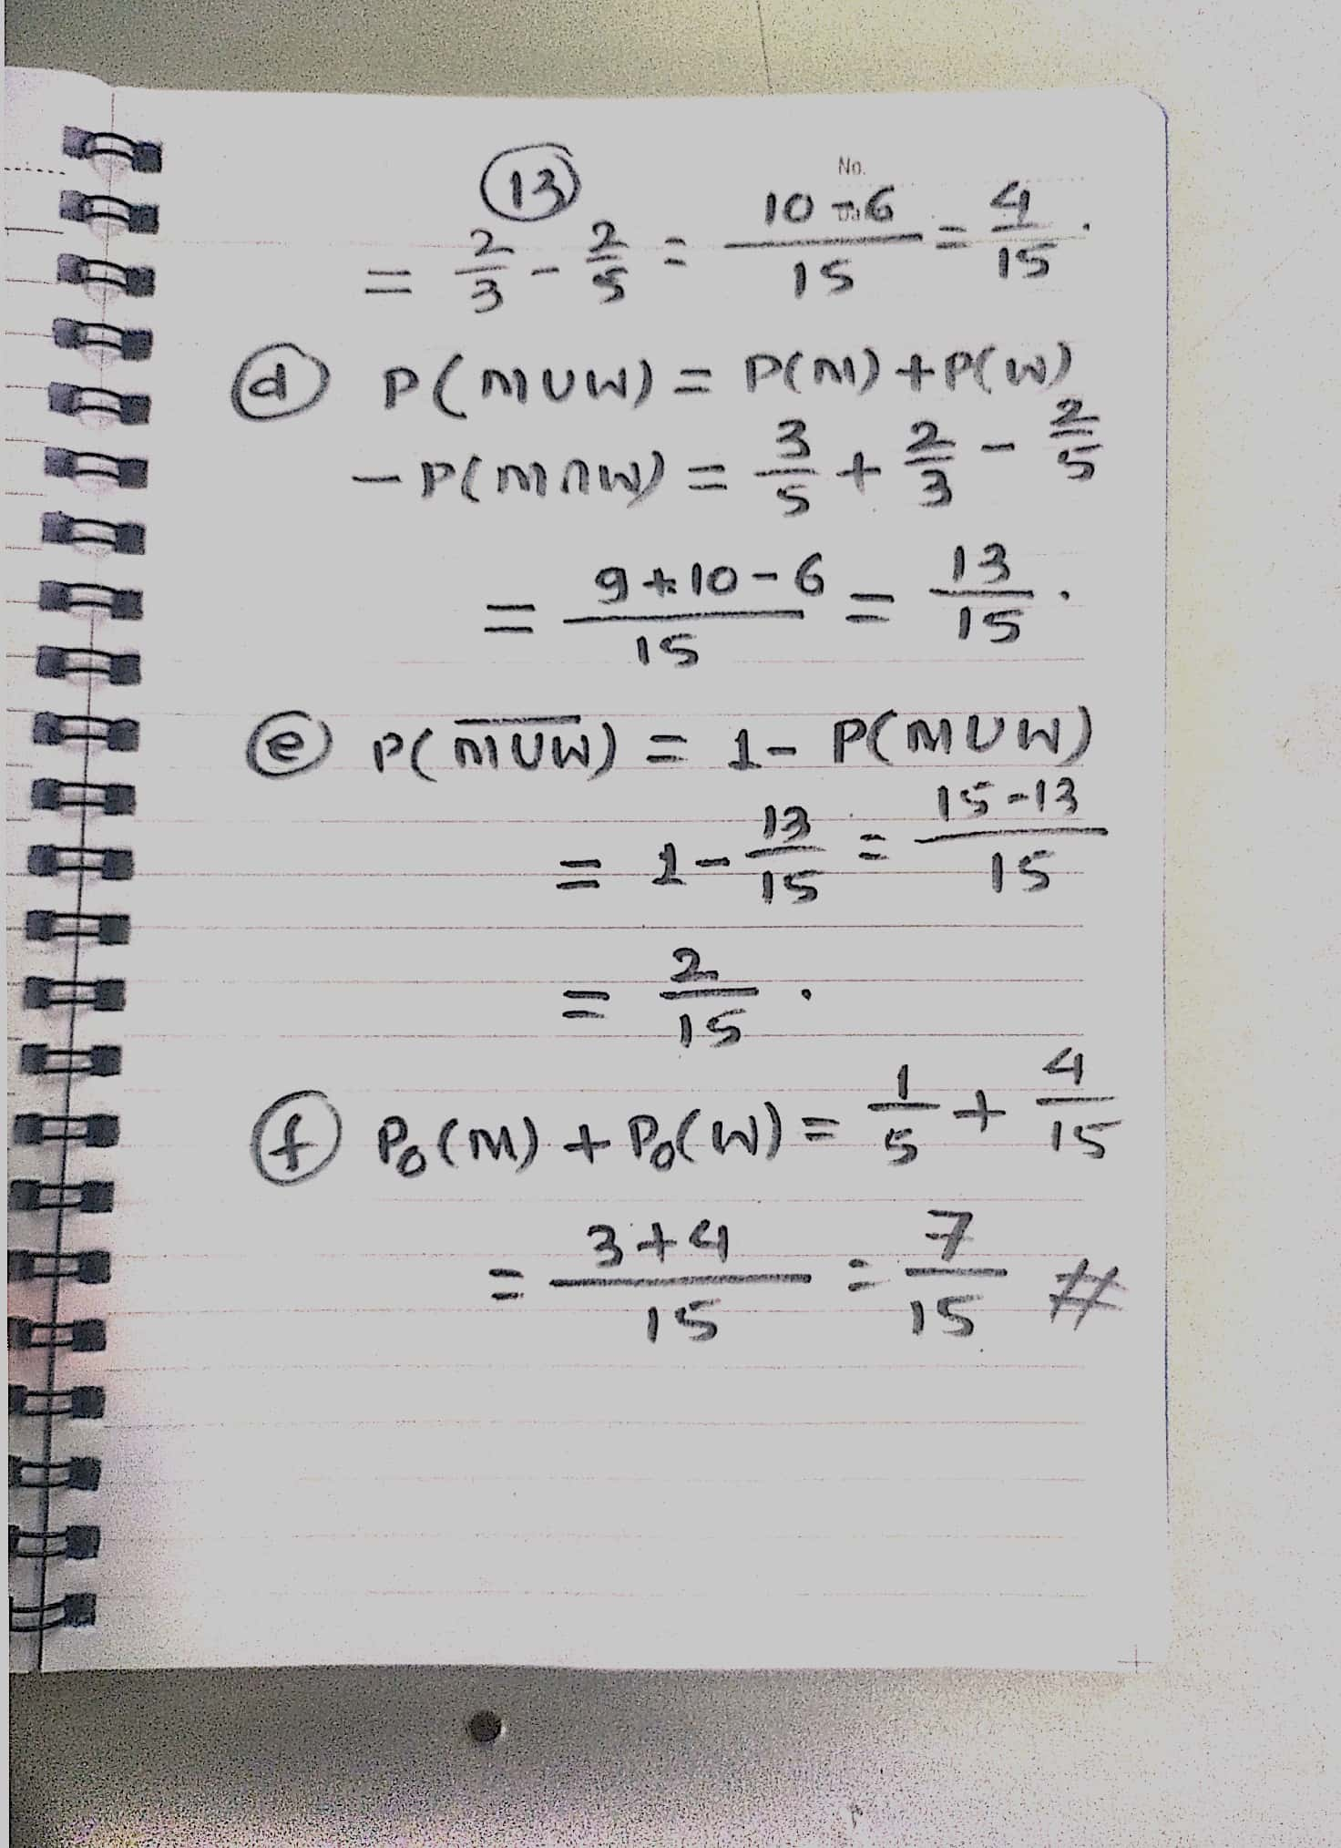

Slide 21
English Calendar
Normal Year / Leap Year :
Jan : 31 / Feb : 28/ 29(Leap Yr)/ Mar: 31 / April: 30
May : 31 / June : 30 / July: 31 / Aug: 31
Sept : 30 / Octob: 31 / Nov: 30 / Dec : 31
Total Days = 365 ( Normal yr) and 366 for Leap year
1 Year = 52 Weeks = 52× 7 Days = 364 Days
Let 1st Day of a Normal Yr be Sunday then End of 52 weeks=364th days will be Saturday and so 365th day i.e. Beginning of 53rd week will again be Sunday.i.e. there be 53 Sunday but remaining are of 52 days.

Slide 22
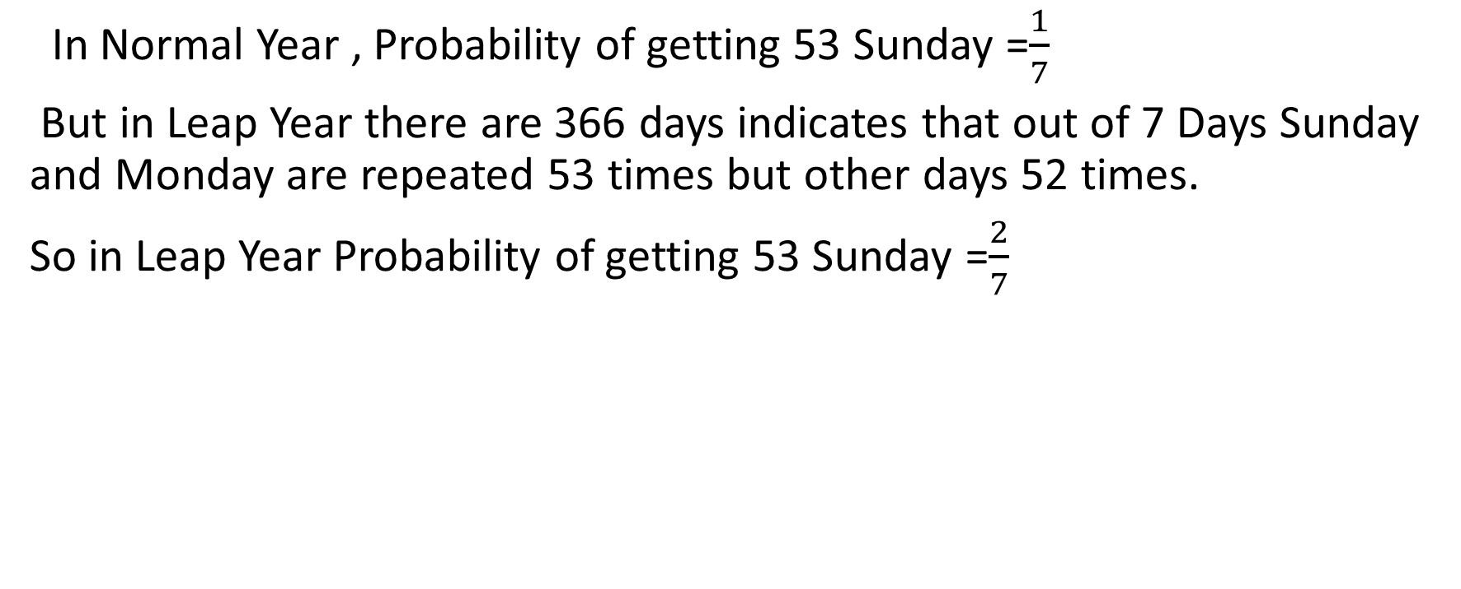
In Normal Year , Probability of getting 53 Sunday =$\frac{1}{7}$
But in Leap Year there are 366 days indicates that out of 7 Days Sunday and Monday are repeated 53 times but other days 52 times.
So in Leap Year Probability of getting 53 Sunday =$\frac{2}{7}$

